Slide 1
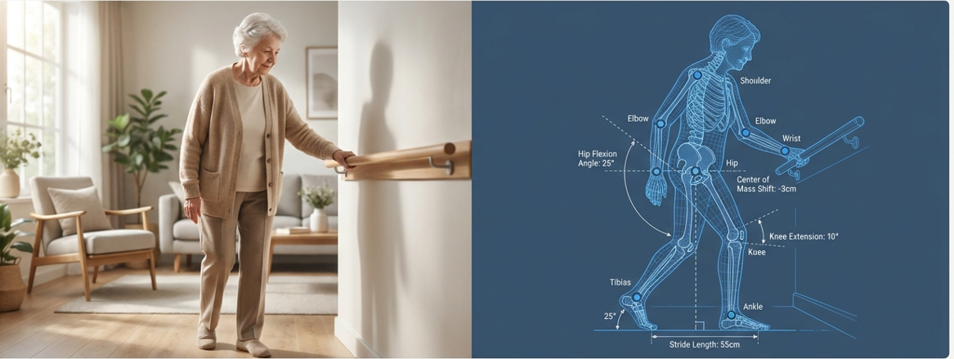

Multimodal Intelligent Fall Monitoring System for
Elderly Care
R26-IT-051

Slide 2
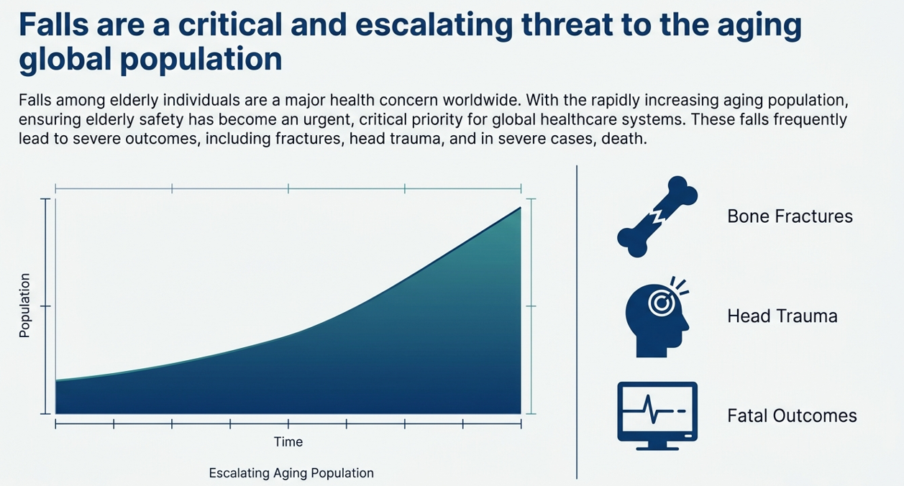
R26-IT-051

Slide 3
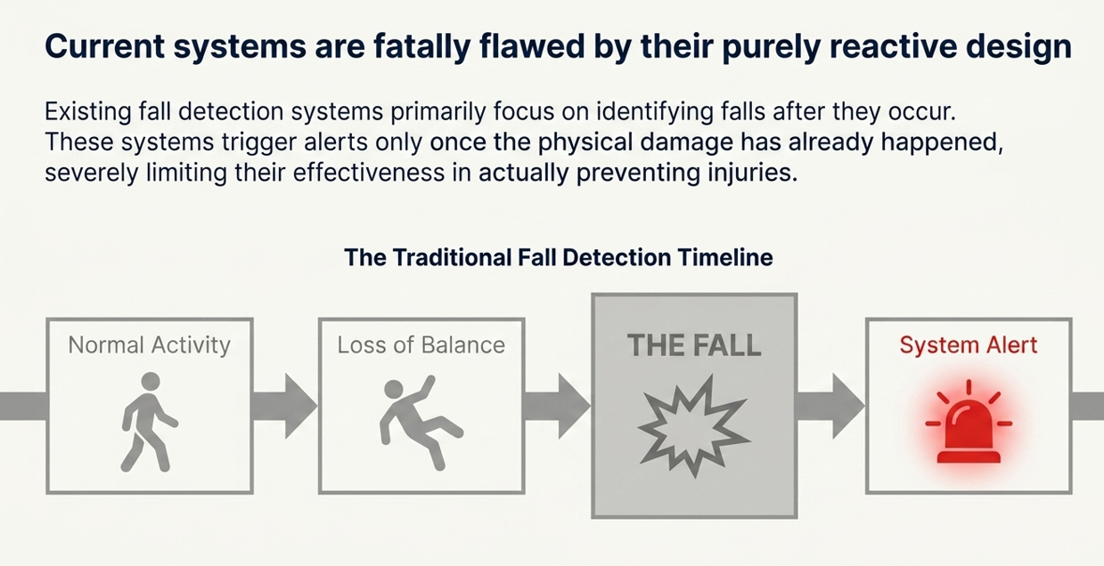
R26-IT-051

Slide 4
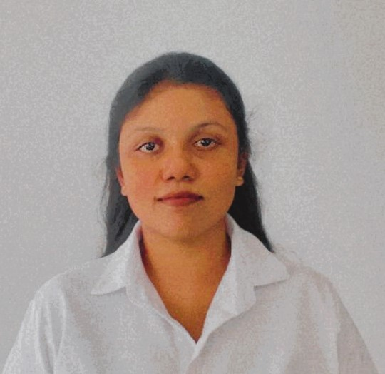
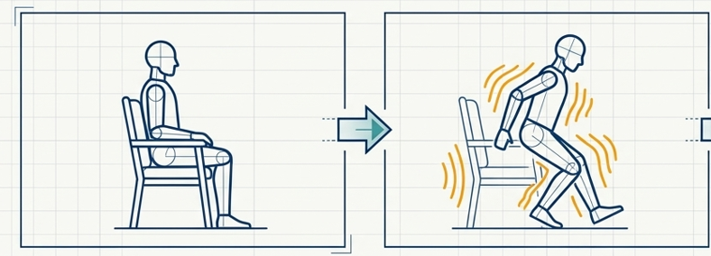
Context-Aware Activity Recognition for Early Fall Risk Detection
IT22548078 | Chathuri M T K | R26-IT-051

Slide 5

Users & Stakeholders
Stakeholders
Family members
Caregivers
Hospitals
Healthcare providers
Primary Users
Elderly individuals
Patients living alone
IT22548078 | Chathuri M T K | R26-IT-051

Slide 6
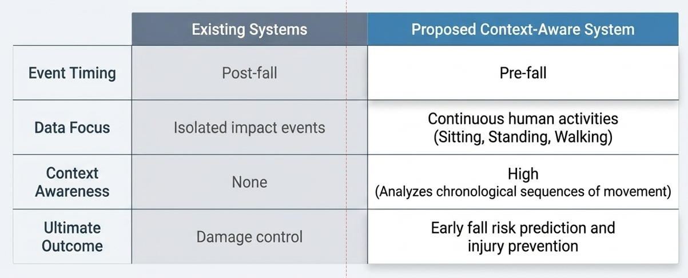
IT22548078 | Chathuri M T K | R26-IT-051

Slide 7
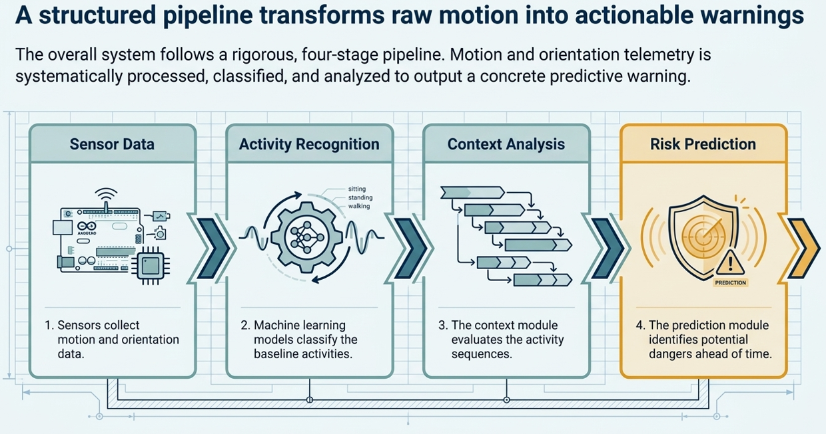
IT22548078 | Chathuri M T K | R26-IT-051

Slide 8
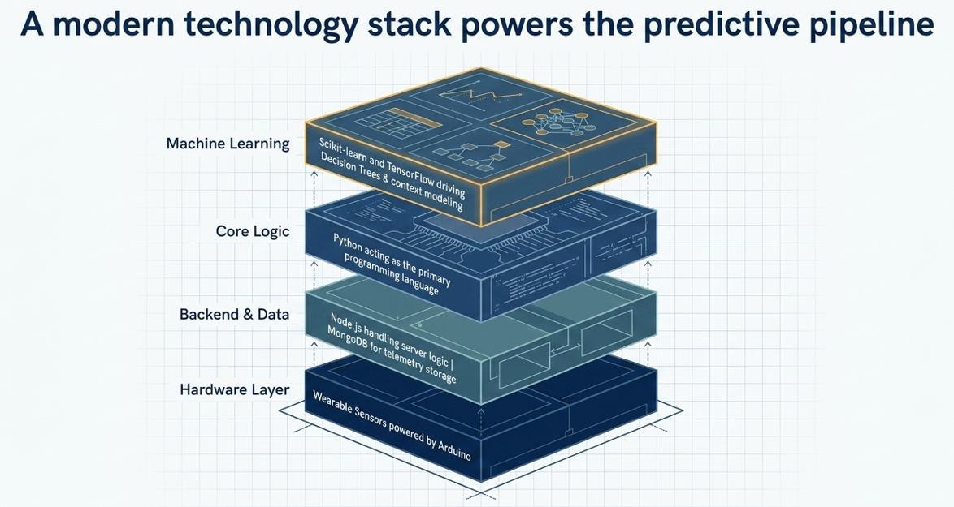
IT22548078 | Chathuri M T K | R26-IT-051

Slide 9
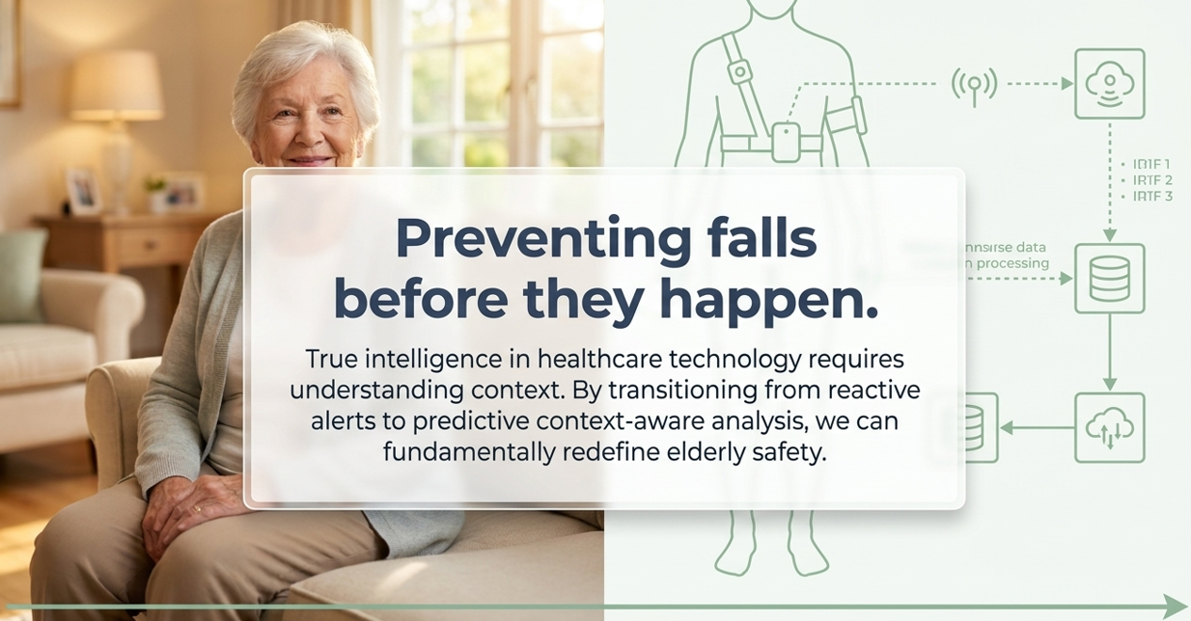

Slide 10
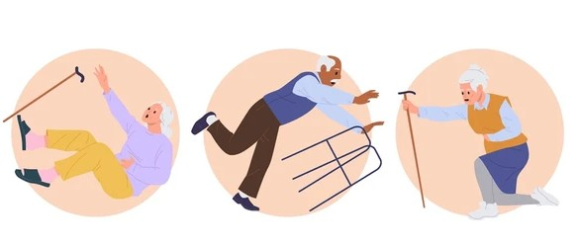
Environmental Risk Mapping &
Smart Safety Zone System
IT22559968| Diwyangi D.H.S| R26-IT-051

Slide 11
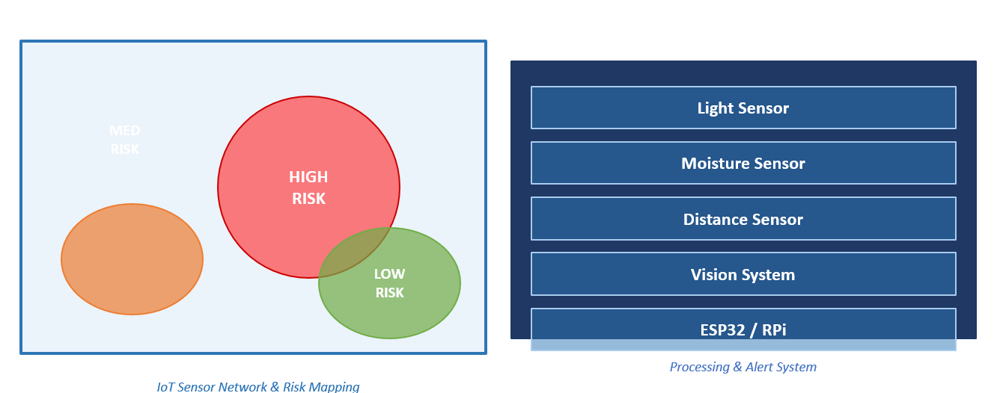
IT22559968| Diwyangi D.H.S| R26-IT-051

Slide 12
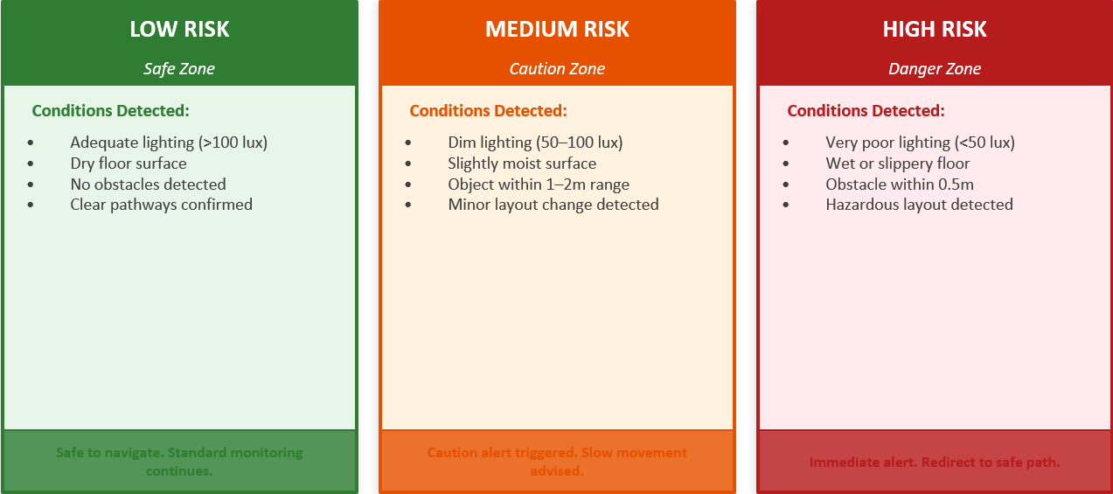
Dynamic Environmental Risk Map
IT22559968| Diwyangi D.H.S| R26-IT-051

Slide 13
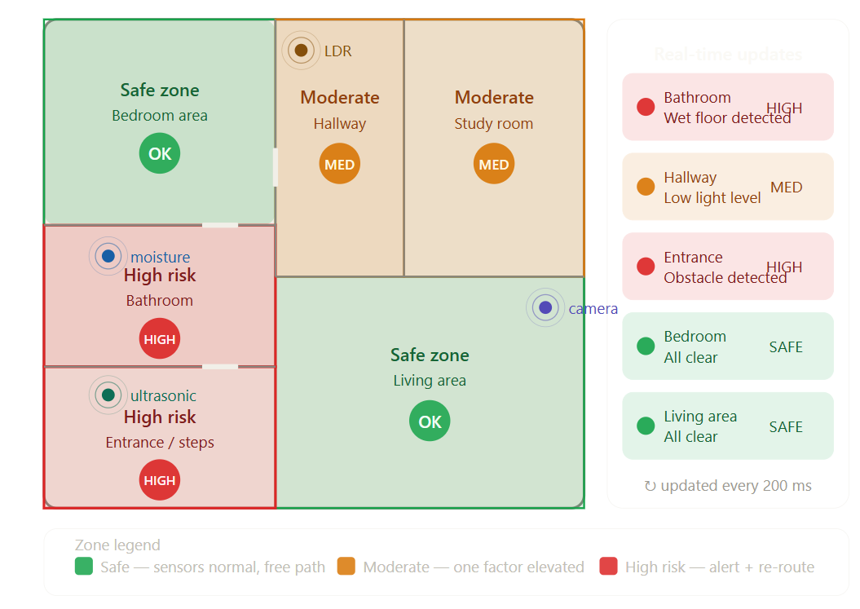
IT22559968| Diwyangi D.H.S| R26-IT-051

Slide 14
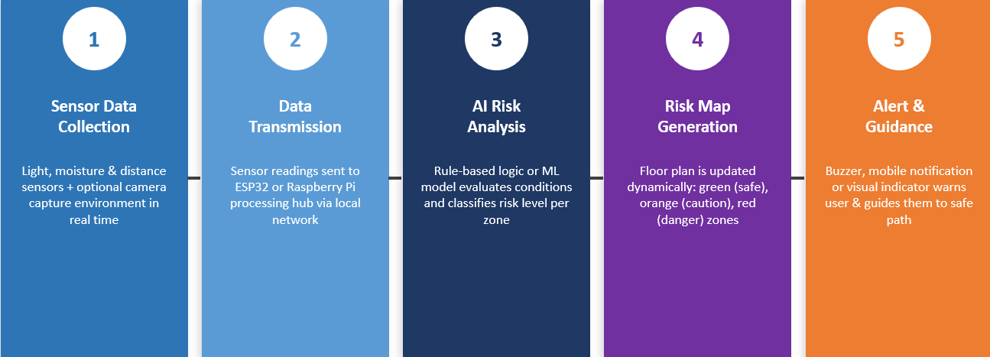
Smart Safety Zone
IT22559968| Diwyangi D.H.S| R26-IT-051

Slide 15
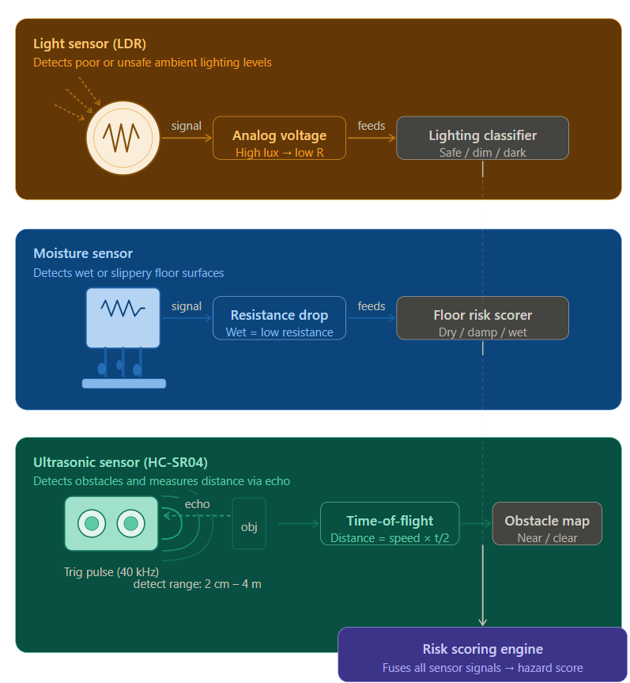
IT22559968| Diwyangi D.H.S| R26-IT-051

Slide 16
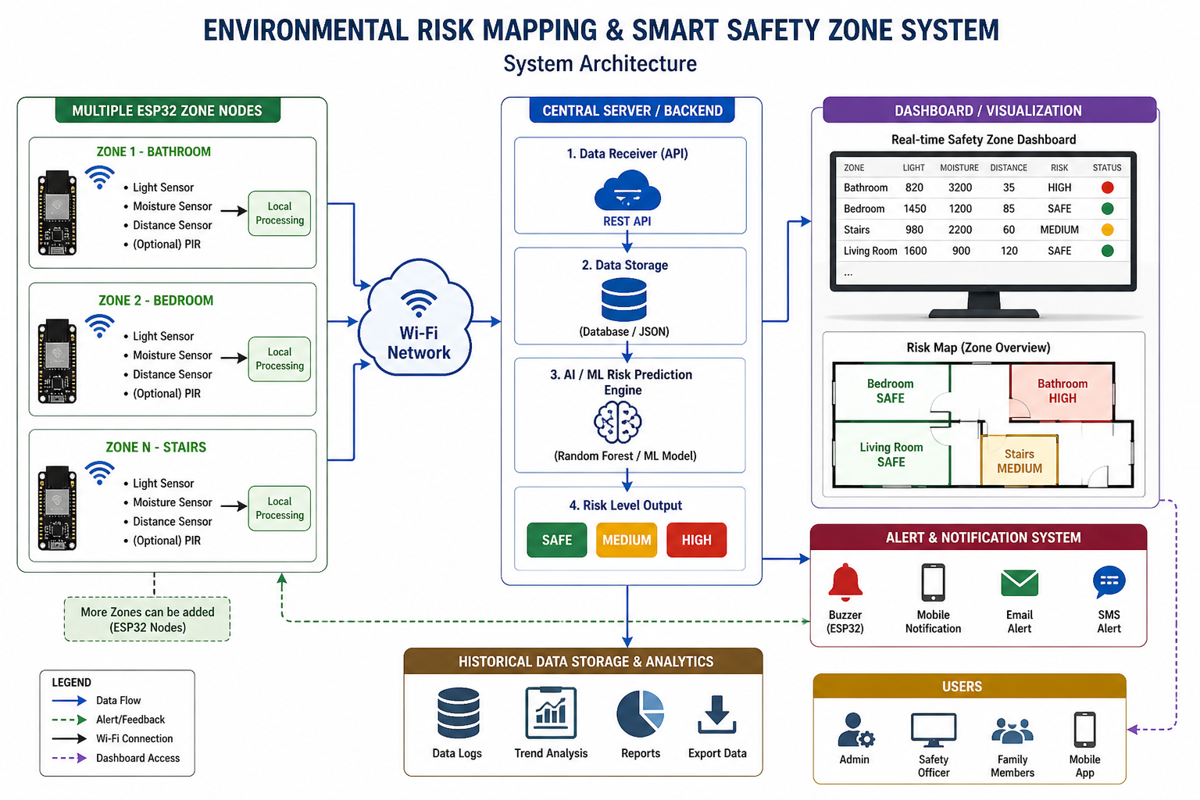
IT22559968| Diwyangi D.H.S| R26-IT-051

Slide 17
Intelligent Monitoring Dashboard
Component 3: Advanced Visualization & Decision Support System for Hospital Clinical Staff.
Strategic Objective
Bridging the gap between AI-driven Gait Analysis and actionable Clinical Intervention through a high-fidelity monitoring interface.
IT22227690| Divyanjalie W.A.H| R26-IT-051

Slide 18

Primary User: Hospital Staff
Designed for Clinicians
•
Real-time monitoring of multiple patient wards.
•
Detailed Gait parameters for professional diagnosis.
•
High-priority visual and audible alerts for fall risks.
•
Intuitive design to reduce cognitive load on nurses.
IT22227690| Divyanjalie W.A.H | R26-IT-051

Slide 19
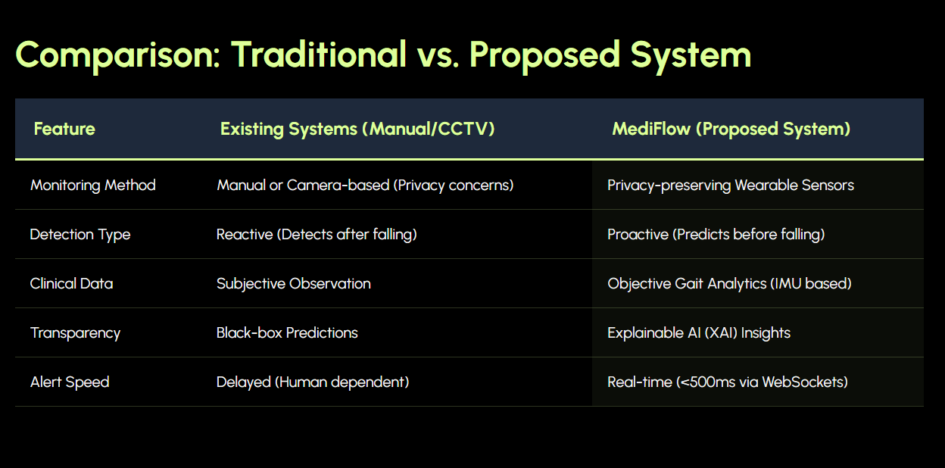
IT22227690| Divyanjalie W.A.H| R26-IT-051

Slide 20






Core Dashboard Pillars
Live Risk Meter
Gait Analytics
XAI Engine
Real-time probability score derived from Single-Sensor IMU data streams.
Visualization of Tilt, Balance, and Speed metrics for clinical deep-dives.
Explainable AI insights providing the "Why" behind every high-risk prediction.
IT22227690| Divyanjalie W.A.H| R26-IT-051

Slide 21
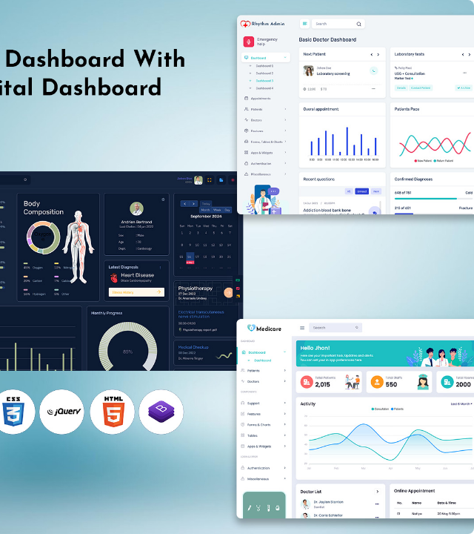
Centralized Ward View
The ward-level monitoring interface allows nursing staff to oversee all patients simultaneously.
High-risk candidates are automatically moved to the top of the grid with distinct visual warnings.
Eliminating the need for manual hourly checks, the system provides 24/7 proactive surveillance.
IT22227690| Divyanjalie W.A.H| R26-IT-051

Slide 22
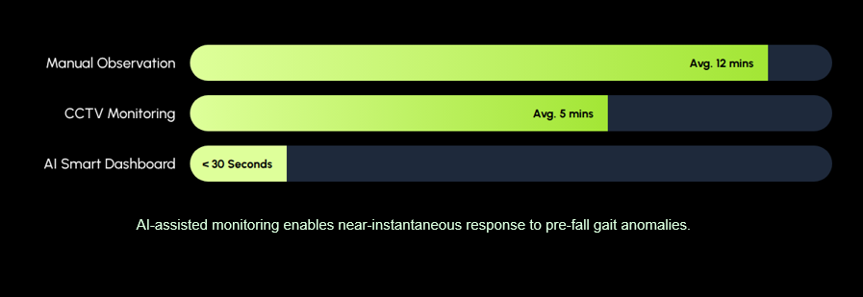
Reducing Response Time
IT22227690| Divyanjalie W.A.H| R26-IT-051

Slide 23
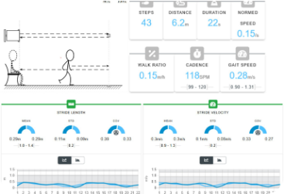
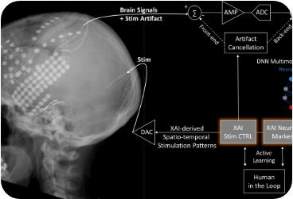
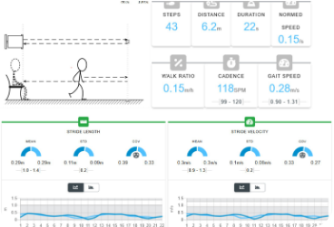
Visualizing Gait Parameters
Signal Analysis
Feature Mapping
Posture Stability
Cleaned IMU signal representing walking cadence and rhythm.
Identifying the specific sensor features contributing to fall risk.
Real-time calculation of Center of Mass (CoM) fluctuations.
IT22227690| Divyanjalie W.A.H| R26-IT-051
Notes:
Instead of just saying a patient is "High Risk," the AI explains why. For example, it can show if the risk is due to "low speed" or "loss of balance." This is the Explainable AI (XAI)
tracks the patient's balance and their Center of Mass (CoM) second by second as they move.

Slide 24
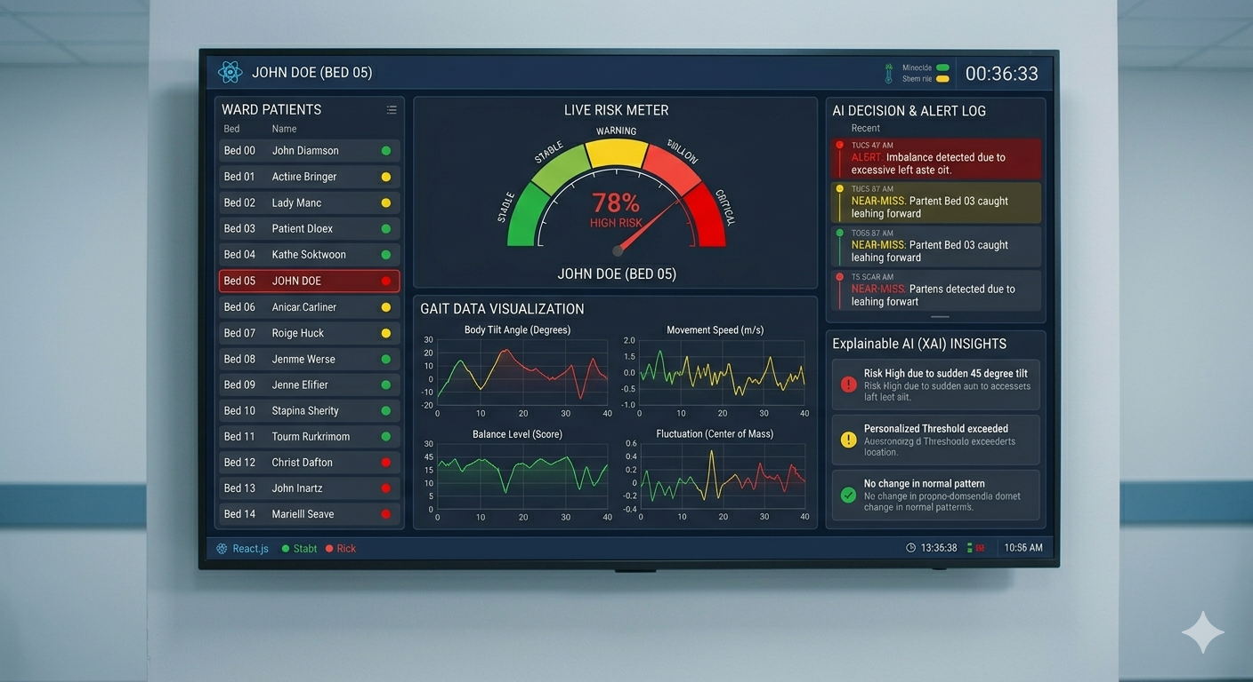
IT22227690| Divyanjalie W.A.H| R26-IT-051

Slide 25
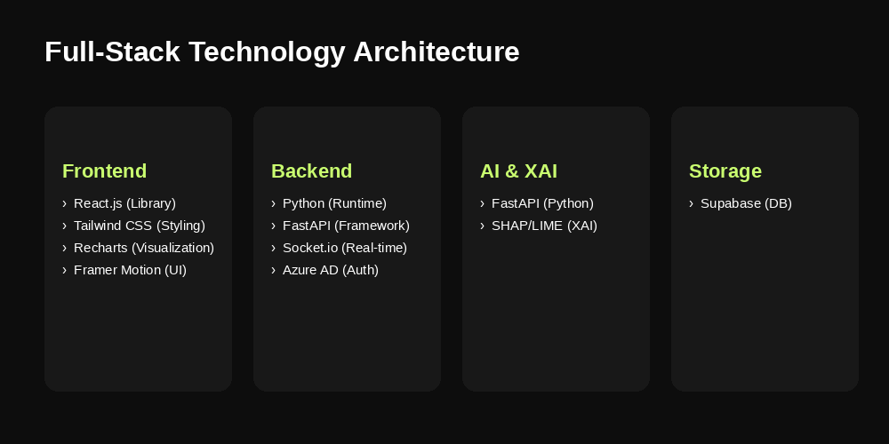
IT22227690| Divyanjalie W.A.H| R26-IT-051

Slide 26
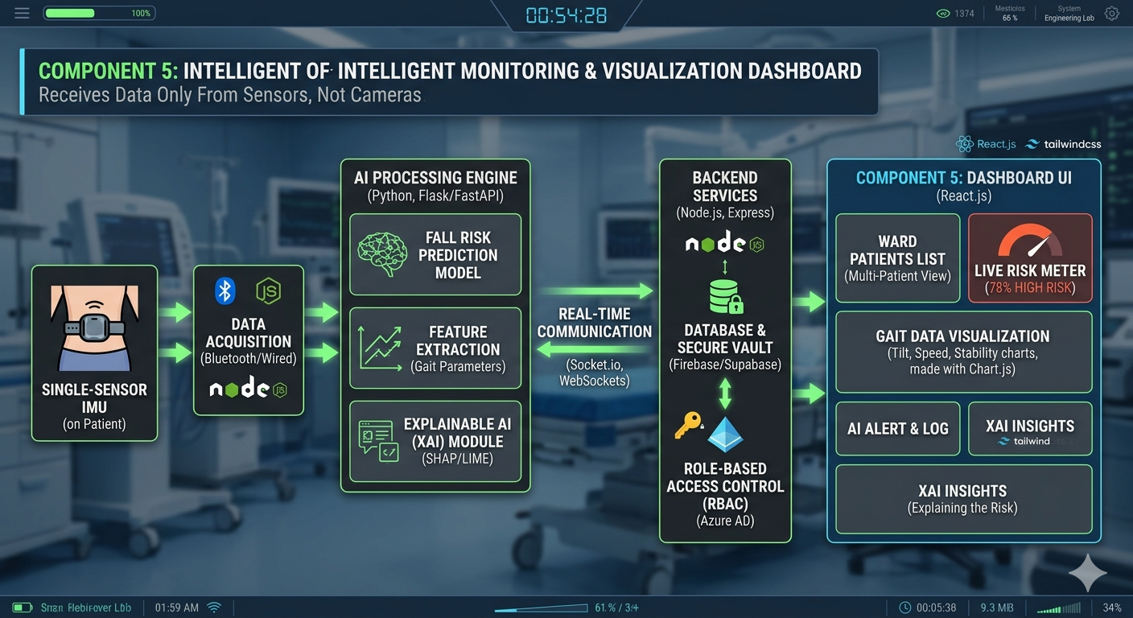
IT22227690| Divyanjalie W.A.H| R26-IT-051
Notes:
recharts: Turns raw patient data into easy-to-read graphs.
Framer Motion: Adds smooth animations to make the UI feel responsive.
Socket.io: Crucial for Real-time updates
Azure AD: Ensures only authorized hospital staff can log in (Security).
FastAPI: A high-speed bridge that connects the AI models to the backend.
SHAP/LIME (XAI): The "Explainable" part—it tells the doctor why the AI flagged a patient as high risk.

Slide 27

Intelligent Multi-Level Alert System for Elderly Safety Monitoring
A real-time smart alert system designed to detect high-risk situations such as falls in elderly individuals and trigger immediate emergency notifications.
IT21066948| Kulathunga E D K M| R26-IT-051

Slide 28
Users & Stakeholders
Elderly users
Caregivers and family members
Hospitals and healthcare providers
Emergency response teams
Assisted living facilities
IT21066948| Kulathunga E D K M| R26-IT-051

Slide 29
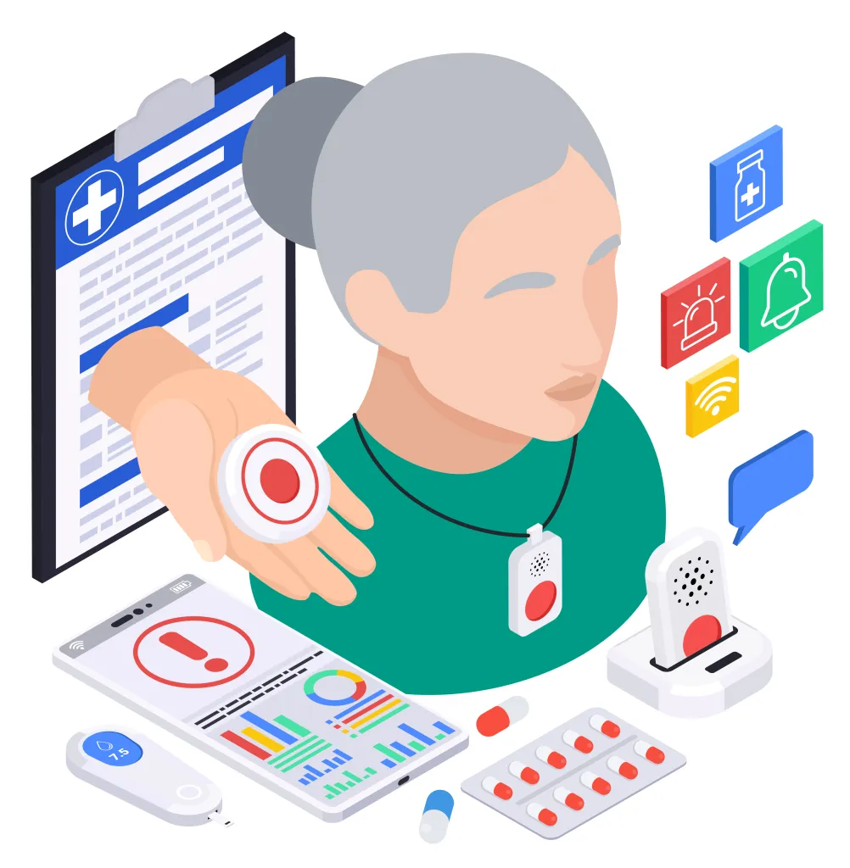
Motivation
Falls are a major risk for elderly people
Delayed help can lead to serious injuries
Many elderly people live alone without support
Need for a fast and reliable alert system
IT21066948| Kulathunga E D K M| R26-IT-051

Slide 30
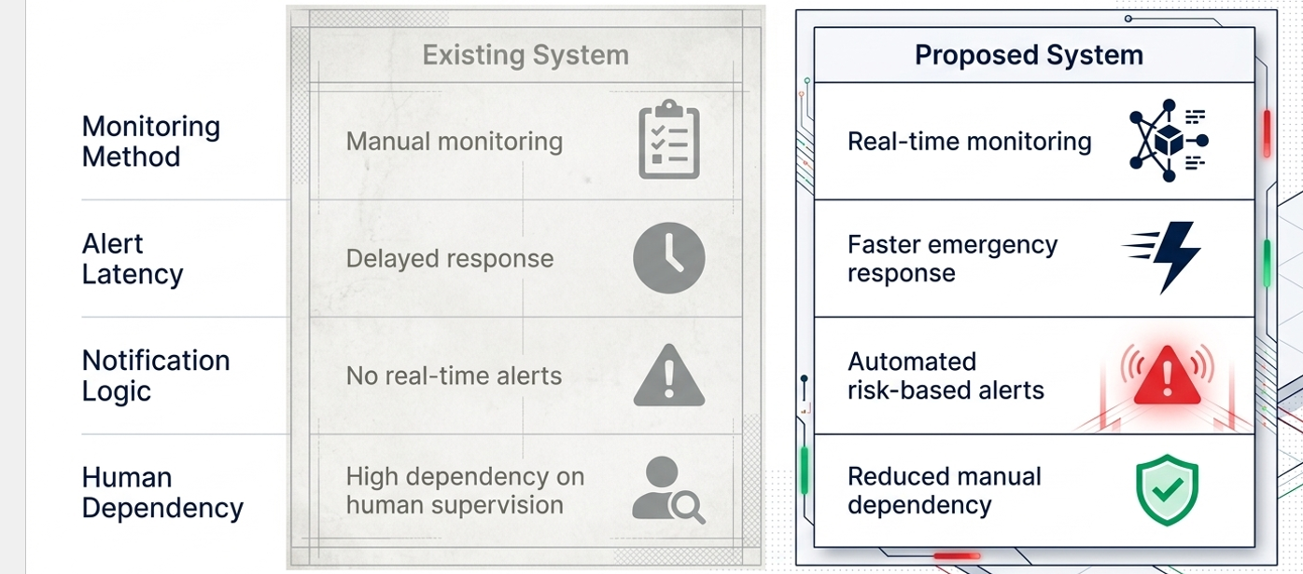
Existing System vs Proposed System
IT21066948| Kulathunga E D K M| R26-IT-051

Slide 31
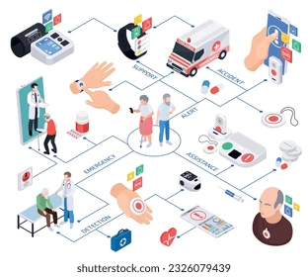
System Overview
Collects data from sensors / user input
Processes the detected event
Identifies emergency situations
Sends alerts to connected users
IT21066948| Kulathunga E D K M| R26-IT-051

Slide 32
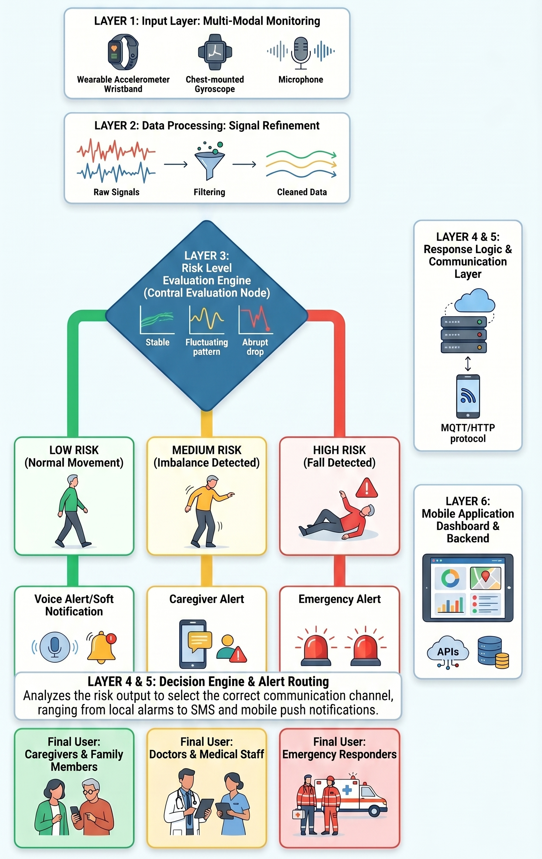
System Architecture
IT21066948| Kulathunga E D K M| R26-IT-051

Slide 33

Key Features
Real-time emergency alerts
Automatic fall detection
Quick notification system
Easy to use interface
Reliable and fast response
IT21066948| Kulathunga E D K M| R26-IT-051

Slide 34
System Flow
Input captured from sensors or manual trigger
System continuously monitors conditions
Emergency condition identified
Alert is generated instantly
Notifications sent to relevant users
IT21066948| Kulathunga E D K M| R26-IT-051

Slide 35
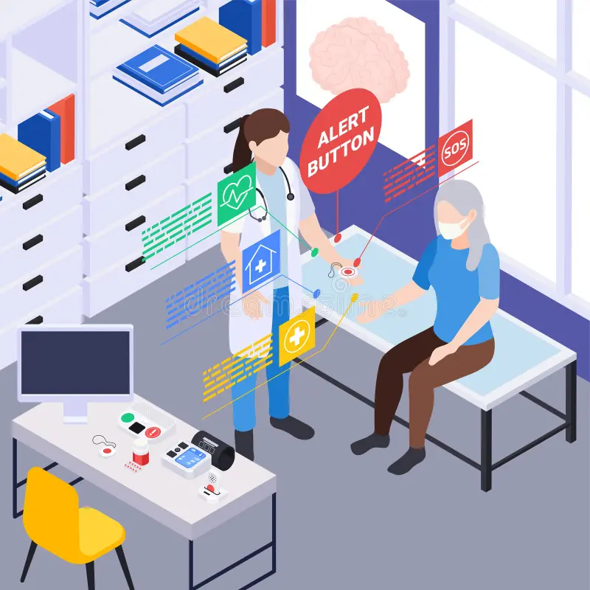
Expected Outcome
Faster emergency response
Improved safety for elderly individuals
Reduced risk of serious injury
Increased confidence for caregivers
IT21066948| Kulathunga E D K M| R26-IT-051

